Slide 1
Sales Data Analysis
Presented by: Akshay Sowdari
Last Updated: December 24, 2022

Slide 2
Problem Statement
A retail manufacturer selling to retailers is seen in attached dataset. Client is eager to have a deeper understanding of their company's sales and profitability. To help this organization gain better visibility on this dataset, an in-depth analysis has done to provide useful insights.

Slide 3
Data Understanding
Data is provided in excel sheet format which contains 9 tables. Each table has several records and fields. Detailed description of tables is provided below.
Table Name | No.of Records | No.of Fields
Categories | 7 | 3
Customers | 92 | 12
India City Lat Long | 58 | 4
Employees | 47 | 9
Offices | 5 | 3
Order Details | 4022 | 7
Orders Header | 1533 | 9
Products | 77 | 4
Supplier | 30 | 5

Slide 4
Data Preparation
Data Cleaning has been carried out as part of data preparation using MS Excel, as it works efficiently on smaller datasets. Observations are followed as
No duplicates are found.
Irrelevant data types are not found.
Proper formatting has been done.
Fixed calculation errors.
No outliers are detected.
Handled missing values by replacing them with Null.

Slide 5
Exploratory Analysis and Modeling
Identified key fields and made appropriate associations by Qlik Data Manager, an abstract view of data fields and associations is provided in next slide.
Master items with calculated fields have been created which can be reused throughout the sheets.
Sales.
Cost of Sales.
Gross Profit.
Total Customers.
Total Orders.
Total Products.

Slide 6
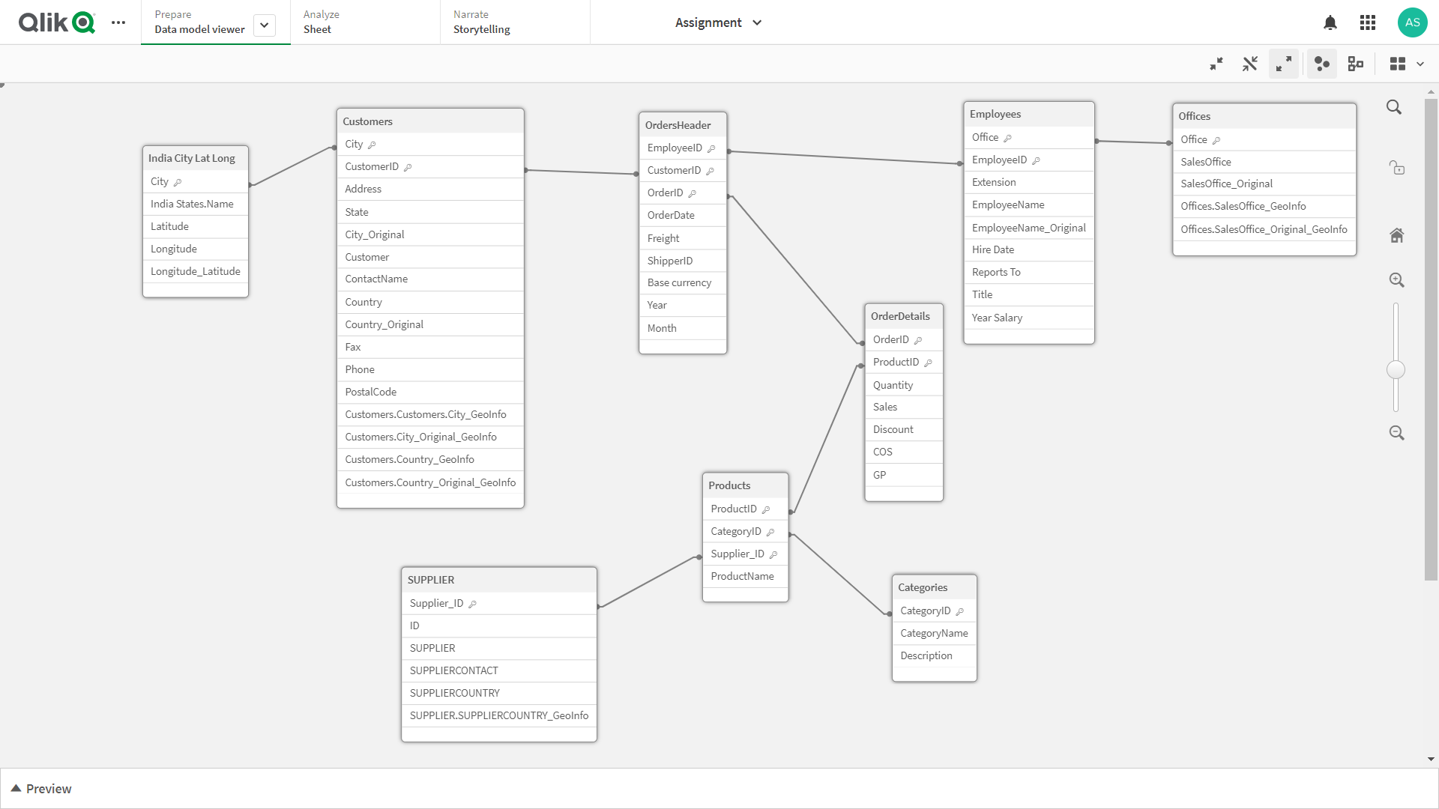

Slide 7
Building App on Qlik Sense
To gain insights and get clear understanding of data , a dashboard with four sheets has been built on Qlik Sense Cloud
Link to Qlik App : https://ob302397aujb403.sg.qlikcloud.com/sense/app/7058ada7-06ba-4b5f-86ed-7e66e876a208/overview

